Slide 1
Retirement Income Pensions/Annuities Social Security/Railroad Retirement Benefits/ IRAs/401Ks
Pub 17 Chapter 10 & 11
Pub 4012 Tab D
(1040-Line 16)
(NJ 1040-Lines 19a & 19b)
Notes:
1

Slide 2
Traditional IRA
Must have earned income & be < 70½ to contribute
Federal rules:
Contributions tax deductible in the year made for Federal
Current limit – $5,500/$6,500 if >/= 50 years of age
May be reduced based on retirement plan, filing status, income
Contributions can be made up to tax return due date & applied retroactively to tax year
Discussed in depth in Adjustments module
Earnings accumulate tax deferred
Distributions taxable in the year received
Notes:
2

Slide 3
Traditional IRA
(cont’d)
NJ rules:
Contributions to IRA are not deductible in the year made
Therefore, contributions may not be taxable when distributed
Earnings accumulate tax deferred, but earnings taxed when distributed
Required Minimum Distribution (RMD) by April 1 following year taxpayer turns 70½ (or 50% penalty)
If born on or before 6/30 - Take RMD by 12/31 of that year, to avoid having to take double RMD the next year
Notes:
3

Slide 4
Roth IRA
(cont’d)
No Required Minimum Distribution (RMD)
Amounts withdrawn from Roth IRA cannot be used to satisfy RMD for Traditional IRA
Earnings accumulate tax free (not just tax deferred)
Distributions are generally not taxable
Exception: Distribution within 5-yr qualifying period from date Roth IRA was first established may be subject to tax on earnings plus 10% early distribution penalty
Rules for taxability of distributions are the same for NJ
Notes:
4
Explain that “tax free” means never having to pay tax; “tax deferred” means you can put off paying the tax, but you must pay tax in the future

Slide 5
401k Plans
Employer-sponsored plans
Pre-tax contributions (99.9% of cases)
If any contributions were after-tax (unusual), distributions are Out Of Scope
Earnings accumulate tax deferred
Distributions taxable in the year received
Required Minimum Distribution (RMD) by April 1 following the first year after the later of:
Year taxpayer turns 70½ OR
Year in which taxpayer retires
Contributions are pre tax in NJ starting 1/1/84
Notes:
5

Slide 6
1099-R Distributions
(cont’d)
Box 7 is checked if distribution is from an IRA/SEP/Simple plan
IRA distributions are reported on a different line (1040 Line 15) than pension/annuity distributions (1040 Line 16)
All 1099-R distributions are reported on NJ 1040 Line 19
Total Employee Contributions in Box 9b – the amount reported here is not taxable but must be allocated across expected life of pension
Used when completing Simplified General Rule Worksheet
IRA contributions not taxed in NJ when distributed (after-tax contributions)
NJ taxes certain 1099-R distributions differently than Federal
Military pensions taxable for Federal, tax exempt in NJ *
Railroad Retirement pensions taxable for Federal, tax exempt in NJ *
Disability pensions for people under company minimum retirement age are treated as taxable wages for Federal, while tax exempt in NJ for people under 65
* Covered in later slides
Notes:
6

Slide 7
Distribution from Retirement Form 1099-R – TS Tips
(cont’d)
If total distribution, check box in 2b
Enter any codes in Box 7
For IRA distributions - check IRA/SEP/Simple 1099-R box
TaxSlayer transfers gross amount of pension to 1040 Line 16a & taxable amount to Line 16b; if distribution is from an IRA (based on check in box 7), gross amount will transfer to Line 15a & taxable amount to Line 15b
Taxable amounts from Federal 1040 Lines 15b and 16b transfer to NJ 1040 Line 19a
Notes:
7

Slide 8
Public Safety Officer Pension
When accident, health or long-term care insurance premiums are deducted directly from pension check, a former Public Safety Officer is allowed up to a $3,000 reduction in taxable income
Enter in Federal section \ Income \ Enter Myself \ IRA/Pension Distributions (1099-R, 1099-SSA)
Do not include the insurance premiums (up to $3,000) in the taxable amount entered in Box 2a
Click on Options under Box 2a to enter the amount of premiums to be excluded from taxable income
Amounts entered as nontaxable cannot also be included on Schedule A as medical expenses
Notes:
How would we know? Client would have to disclose that they are public safety officer (Police, Fireperson, Rescue Squad, chaplain)
To avoid giving officer a double benefit, you cannot also deduct medical insurance premium on Sch A for these premiums
8

Slide 9
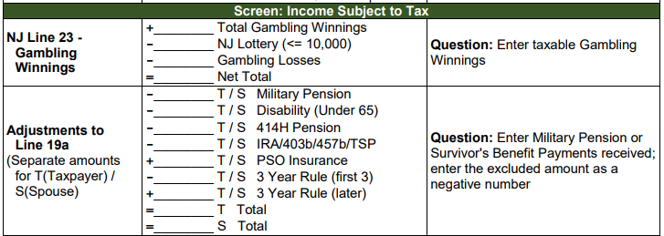
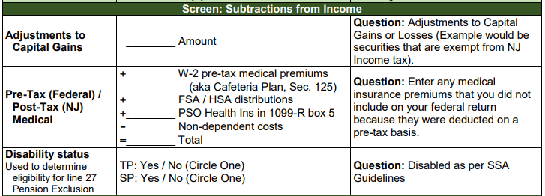
Public Safety Officer Pension
(cont’d)
Capture premium amount in NJ Checklist Income Subject to Tax and Subtractions from Income sections for later entry in the TaxSlayer State section
To add premiums back into taxable NJ Pension income on Line 19a,
since cannot be excluded for NJ
To add premiums to NJ medical expenses
Notes:
How would we know? Client would have to disclose that they are public safety officer (Police, Fireperson, Rescue Squad, chaplain)
To avoid giving officer a double benefit, you cannot also deduct medical insurance premium on Sch A for these premiums
9

Slide 10
NJ Retirement Income Topics
Special topics relating to NJ tax law on retirement income to be discussed on subsequent slides
Military pensions
NJ 1040 Pensions/Annuities/IRA Withdrawals (NJ 1040 Lines 19a/19b)
Rules on taxability of NJ retirement income
NJ IRA Worksheet for IRAs, 403b, 457b, Thrift Savings Plan
NJ contributory pensions
3-year rule for pensions
NJ pension exclusion
NJ other retirement income exclusions
Notes:
This is just a summary page to introduce some other special topics relating to retirement income that we will be discussing on subsequent slides. Do not discuss any of these topics in detail now. Just mention them so students will know what is coming

Slide 11
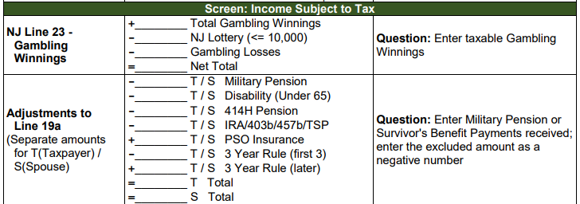
Military Pensions on NJ Return
Military pensions are not taxable in NJ
Amount of military pension will flow through from entry of 1099-R in Federal section, so must tell TaxSlayer to subtract this from NJ taxable income
Capture the amount of the military pension in NJ Checklist Income Subject to Tax section for later entry in TaxSlayer State section

Slide 12
NJ 1040 Line 19 Pensions/Annuities/IRA Withdrawals
NJ 1040 includes all distribution amounts from pensions, annuities, and IRAs on Line 19
NJ does not have separate lines for IRAs vs. pensions/annuities as Federal 1040 does
NJ 1040 Line 19a includes all the taxable distribution amounts
NJ 1040 Line 19b includes all excludable amounts
Total of Lines 19a + 19b should equal the total of all 1099-R Box 1s
Does not include 1099-Rs for distributions that are totally tax-exempt, such as military pensions, disability pensions for persons under 65, Railroad Retirement Tier 2 pensions. These items do not appear on NJ 1040 at all

Slide 13
NJ 1040 Line 19b – Excludable Pensions, Annuities, & IRA Withdrawals
NJ 1040 Line 19b is used to show the excludable portion of any distribution you received from a contributory pension, annuity, or IRA. This is the amount that represents your previously taxed contributions to the plan
To determine the excludable amount to enter, add together:
Non-taxable amounts calculated on the Simplified General Rule Worksheet
The difference amount anytime the 1099-R Box 1 (gross distribution) is different than Box 2a (taxable amount)

Slide 14
NJ 1040 Line 19b – Excludable Pensions, Annuities, & IRA Withdrawals
(cont’d)
The full amount received when using the Three-Year Rule until all of the contributions are recovered
Do not include pensions that are not taxed in NJ such as military pensions, disability pensions under 65, and Railroad Retirement Tier 2 pensions
Refer to TaxPrep4Free.org “NJ Special Handling” document on Preparer page for details

Slide 15
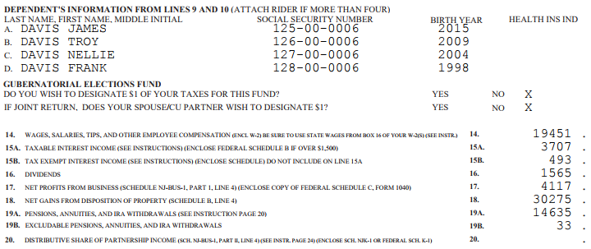
TS - Retirement Income on NJ 1040 Lines 19a & 19b
Line 19a: Taxable part of pensions/annuities/IRAs
Line 19b: Excludable part of pensions/annuities/IRAs

Slide 16
Rules on Taxability Of Retirement Income - NJ
Contribution | Contribution Made with After-NJ-Tax Money | Taxable on Distribution
Employer contributions | N/A | YES
Employee contributions paid with pre-tax dollars to 401K | NO | YES
Employee contributions paid with after-tax dollars (including IRA) | YES | NO
Earnings on both employer & employee contributions | N/A | YES
Notes:
Summary of taxability of different parts of retirement income

Slide 17
IRAs, 403b, 457b, Thrift Savings Plans
Distributions from IRAs, 403b, 457b, and Thrift Savings Plans (TSPs) are taxed in NJ except for the portion that represents taxpayer contributions
Contributions were made with after-NJ-tax money, so not taxed upon distribution
To determine NJ taxability amount of any of these distributions, the portion of the distribution that represents taxpayer contributions is allocated over expected number of distribution years
Taxpayer must know total contributions
May be able to get info for some of these plans from NJ Division of Pensions and Benefits or from plan administrator. Taxpayers would have to know IRA contributions from their own records
Use NJ IRA Worksheet on TaxPrep4Free.org to determine the taxable and nontaxable amounts (if contributions are known)

Slide 18
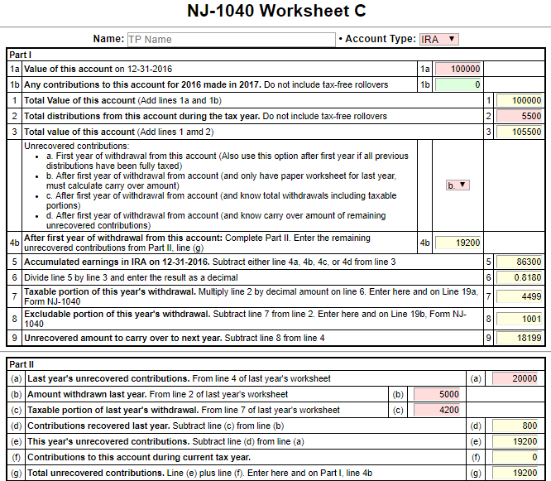
NJ IRA Worksheet on TaxPrep4Free.org to determine Taxable and Nontaxable Portions of IRAs, 403b, 457b, Thrift Savings Plans
Enter as adjustments to Lines
19a and 19b on NJ Checklist

Slide 19
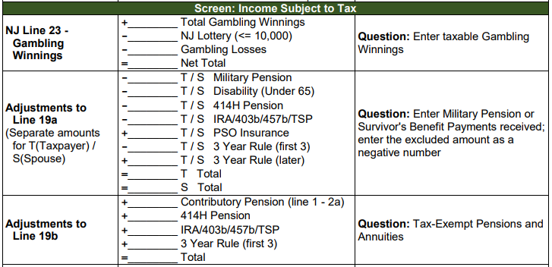
Adjustments on NJ Checklist to Reflect Taxable and Nontaxable Portions of IRAs, 403b, 457b, Thrift Savings Plans
Subtract tax-exempt amount
from Line 19a
Add tax-exempt amount to Line 19b

Slide 20
NJ Contributory Pensions
A retirement plan in which employee contributes a portion of base salary into pension plan. Employer may make contributions also
We see a lot of these for former NJ state and municipality workers
At retirement, retiree receives a set amount each month
Taxability of distribution depends on whether contributions were taxed when made
Federal tax treatment
Employee contributions made prior to 1/1/87 were made with after-tax money that was included in W-2 wages when contributed. Contributions after 1/1/87 were made with pre-tax money and not included in W-2 wages
Optional pension membership credit purchased before 2002 were also after-tax
At distribution, the pre-tax contributions plus employer contributions and earnings are taxable
After-tax contributions can be recovered evenly over taxpayer’s expected lifetime or combined lifetime with spouse (if joint and survivor annuity)
Notes:
For 414H pension for state or municipal workers, the NJ Division of Pensions and Benefits sends out a letter detailing the Federal after-tax employee contributions and the total employee contributions, along with associated instructions, when employee retires. If letter is not available, retiree can call Office of Client Services for the Pension Division at (609) 292-7524 or send an email to pensions.nj@treas.nj.gov
For other contributory pensions, retiree may be able to get needed information from pension plan administrator or former employer

Slide 21
NJ Contributory Pensions
(cont’d)
Federal after-tax contributions are shown on 1099-R in Box 9b. Usually current year’s excludable amount is shown in Box 5, and then reflected in the taxable amount shown in Box 2a
If taxable amount is not shown in Box 2a, use the Simplified General Rule Worksheet in TaxSlayer or the Bogart Annuity Calculator on TaxPrep4Free.org to determine the taxable amount, based on the amount in Box 9b
NJ tax treatment
All employee contributions are made with after-NJ-tax money that is included in W-2 NJ State Wages when contributed
Therefore, all employee contributions are tax-exempt upon distribution. Only employer contributions and earnings are taxable for NJ
To determine the NJ taxable amount, must use total employee contributions amount, not the amount shown in Box 9b
Insert total employee contributions in TaxSlayer Simplified General Rule Worksheet or Bogart Annuity Calculator to determine the NJ taxable and non-taxable amounts of the distribution
See Special Topics document “Contributory Pensions” of TaxPrep4Free.org for more details
Notes:
For 414H pension for state or municipal workers, the NJ Division of Pensions and Benefits sends out a letter detailing the Federal after-tax employee contributions and the total employee contributions, along with associated instructions, when employee retires. If letter is not available, retiree can call Office of Client Services for the Pension Division at (609) 292-7524 or send an email to pensions.nj@treas.nj.gov
For other contributory pensions, retiree may be able to get needed information from pension plan administrator or former employer

Slide 22
Example of NJ Contributory Pension
(cont’d)
1099-R Box 1 Gross Distribution $22,000
1099-R Taxable Amount Blank
1099-R Box 9b Employee Contributions $2,000
(Federal after-tax contributions amount)
Total Employee Pension Contributions
(provided by pension administrator or client) $50,000
Using Simplified General Rule Worksheet or Bogart Annuity Calculator:
Using Federal after-tax contributions of $2,000, the Federal taxable amount of the distribution is $21,908
Using total employee contributions of $50,000, the NJ taxable amount of the distribution is $19,692
See Special Topics document “NJ Contributory Pension” on TaxPrep4Free.org Preparer Page for help calculating the correct adjustment amounts for NJ 1040 Lines19a and 19b to enter on the NJ Checklist for later entry in TaxSlayer State section
Notes:
The Federal taxable amount of the distribution will flow through to NJ 1040 Line 19a. Therefore, you must adjust Line 19a to reflect the correct NJ taxable amount
The calculation is: Federal taxable amount minus NJ taxable amount = adjustment amount on NJ Checklist Line 19a. Enter as a negative number
You must also enter an adjustment for Line 19b to reflect the NJ nontaxable amount. This is shown as the excludable amount on the Bogart calculator. It is calculated as: Federal gross amount in 1099-R Box 1 – NJ taxable amount

Slide 23
NJ 3-Year Rule for Pensions Qualifications
May use NJ 3-Year Rule if:
Both you and employer contributed to plan
Will recover your contributions within 36 months of 1st distribution from plan
Must be just starting to collect pension
May exclude all pension distributions from income until distributions = contributions
If pension started in middle of year, could be partially taxable in last year of exclusion
Since Federal taxable amount flows through to NJ 1040 Line 19a, capture the amount that should be tax exempt under the 3-year rule in NJ Checklist Income Subject to Tax section for later entry in TaxSlayer State section
Notes:
To use the 3-year rule you must have started using the rule on the first year you took the distribution (or be able to go back and amend prior returns to show this)
This may be useful for people who retire before 62 ½ because they wouldn’t be eligible for other NJ pension exclusions yet
We do not see this situation very often because:
Taxpayer must have contributed to pension plan along with employer
Must be just starting to collect pension
Must be able to recover all employee contributions within 3 years of first pension payment
Pension Exclusion & Other Retirement Income Exclusions may be enough to exclude all pension income from NJ tax
Check prior year’s NJ return and/or ask taxpayer to see if taxpayer was using 3-year rule for pension last year. If so, use following instructions to continue adjusting NJ return until pension payments = employee contributions

Slide 24
NJ 3-Year Rule for Pensions Qualifications
Once all contributions are recovered under 3-year rule, all of pension distributions will be taxable for NJ. Capture the amount of pension income to be added back into taxable NJ pension income on Line 19a in NJ Checklist Income Subject to Tax section for later entry in TaxSlayer State section
See “NJ Special Handling” document on TaxPrep4Free.org Preparer page for details on entering 3-year rule
Notes:
To use the 3-year rule you must have started using the rule on the first year you took the distribution (or be able to go back and amend prior returns to show this)
This may be useful for people who retire before 62 ½ because they wouldn’t be eligible for other NJ pension exclusions yet
We do not see this situation very often because:
Taxpayer must have contributed to pension plan along with employer
Must be just starting to collect pension
Must be able to recover all employee contributions within 3 years of first pension payment
Pension Exclusion & Other Retirement Income Exclusions may be enough to exclude all pension income from NJ tax
Check prior year’s NJ return and/or ask taxpayer to see if taxpayer was using 3-year rule for pension last year. If so, use following instructions to continue adjusting NJ return until pension payments = employee contributions

Slide 25
NJ Pension Exclusion Qualifications
You &/or spouse/CU partner 62 years+ or blind or disabled (according to SSA guidelines) on last day of year
If only 1 partner qualifies, can still claim up to maximum pension exclusion. However, only retirement income of qualified partner can be excluded
Note the fact that taxpayer and/or spouse is disabled according to SSA guidelines in NJ Checklist Subtractions from Income section for later entry in the State section
Total income from NJ 1040 Line 26 $100K or less

Slide 26
NJ Pension Exclusion Annual Amounts
Based on filing status:
$20K/$40K (2017) – MFJ
$15K/$30K (2017) – Single, HOH, QW
$10K/$20K (2017) – MFS
Maximum exclusion cannot exceed total Pension, Annuity & IRA Withdrawal amount on NJ 1040 Line 19a
Notes:
Pension exclusion claimed on NJ 1040 Line 27a may be less than the maximum exclusion because total Pension, Annuity & IRA Withdrawal amount on Line 19a is less than the maximum

Slide 27
Other Retirement Income Exclusions - NJ1040 Line 27b
2 Parts to Other Retirement Income Exclusions
Unclaimed portion of your Pension Exclusion (NJ 1040 line 27a)
Special exclusion for taxpayers who are unable to receive SS or RR benefits
Each part has different eligibility requirements

Slide 28
Other Retirement Income Exclusions: Unclaimed Pension Exclusion
Did not use maximum Pension Exclusion
You &/or spouse/CU partner 62 years+
Total income from NJ 1040 Line 26 $100K or less
Income from wages, net profit from business, partnership, S corp. income </= $3K
Amount will be maximum pension exclusion minus pension exclusion claimed on NJ 1040 Line 27a
Notes:
Income from wages, net profit from business is made up of NJ 1040 Lines 14+17+20+21

Slide 29
NJ Other Retirement Income Exclusions: For Taxpayers Unable to Receive SS/RR Benefits
Not related to Pension Exclusion & may claim whether or not you use maximum Pension Exclusion
Exclusion amounts $6K – MFJ, HOH, QW; $3K – Single, MFS
You &/or spouse/CU partner 62 years+
Unable to receive SS/RR benefits, but would have been eligible for benefits had you fully participated in either program
Must answer questions under Pension Exclusion in State section \ Edit \ Enter Myself \ Subtractions from Income for TaxSlayer to determine eligibility

Slide 30
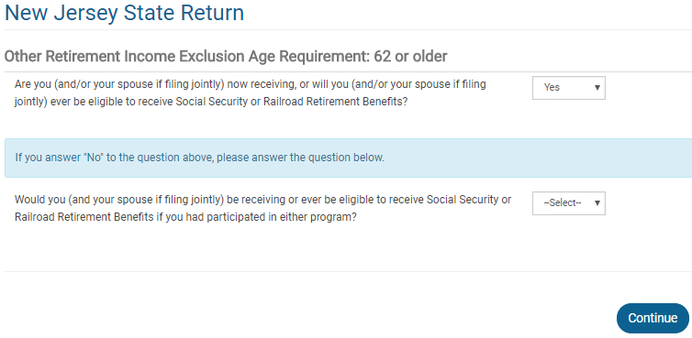
TS – Additional Questions for Other Retirement Income Exclusion State Section \ Edit \ Enter Myself \ Subtractions from Income
Questions to determine eligibility for
Other Retirement Income exclusion

Slide 31
Railroad Retirement Benefits Tier 2 (Pension Equivalent)
Railroad Retirement Tier 2 (Pub 575)
Reported on RRB-1099-R - Green Form
Same rules as pensions
RRB-1099-R Pension (not taxable in NJ)
TaxSlayer automatically excludes the railroad retirement pension amount from NJ income
Notes:
31

Slide 32
Disability Pension on NJ Return
Disability pension is taxed differently in NJ depending on age of recipient
Recipient under age 65 – disability pension is tax exempt
Recipient age 65 or older – disability pension is treated as a regular pension
Amount of disability pension flows through to NJ pension line 19a from entry of 1099-R in Federal section
Does not matter whether disability pension is treated as pension or wages on the Federal return (i.e. – whether recipient is under or over company minimum retirement age)
If disability should be tax exempt because recipient is under age 65, capture the amount of the disability pension in the NJ Checklist Income Subject to Tax section for entry later in the State section
TaxSlayer does not automatically remove this disability pension from NJ 1040 Line 19a for Pensions

Slide 33
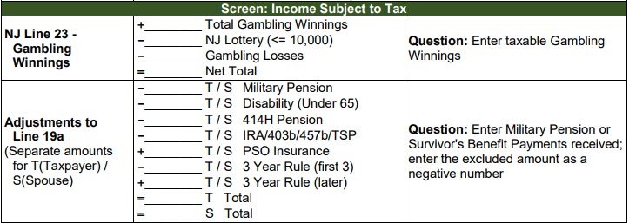
Disability Pension on NJ Return
(cont’d)

Slide 34
TS – Early Distribution Penalty Federal section \ Income \ Enter Myself \ IRA/Pension Distributions (1099-R, 1099-SSA) \ Add or Edit a 1099-R \ Form 1099-R Distribution Penalty
Type of plan distribution received from
Notes:
This screen only appears if 1099-R Box 7 shows a distribution code of 1, which is an early distribution where the issuer does not know of any valid exception

